Slide 1
The First 28 Days of Life - What to Fear in the ED
John Misdary, MD FACEP, FAAEM,FAAP
Attending Physician
St. Joseph’s Childrens Hospital Tampa, FL

Slide 3
Objectives
Review the sick neonate in the 1st month of life
Discuss common and uncommon diagnoses
Evaluate appropriate laboratory and imaging studies
Review treatment and disposition strategies

Slide 4
Clinical Senario 1
4 d/o term male presents to ED with lethargy, poor feeding, bluish color and decreased UOP. Had difficultly latching since birth and worsening since. Symptoms have been worsening last 24 hrs.
He was born at a birthing center by midwife who gave all prenatal care. He has not seen a healthcare provider. No maternal medical history with no medications during pregnancy and no illicit drug use.
The bluish discoloration has been worsening over last 24 hrs with increased WOB and no UOP or feeding in last 6 hrs. Family called midwife who would see child tomorrow, but family was concerned and came to ED.

Slide 5
Physical Exam
VS - T 100.1 HR 178 BP 64/31RR 61 Wt 2.4 kg Pulse Ox 72% RA
Central cyanosis, somnolent not easily aroused, cold and clammy
Depressed Fontanelle
Dry MM
Weak suck
Delayed cap refill pulses difficult to palpate
Tachycardia with continuous murmur
Tachypnea, CTAB with no retractions
Abdomen soft with palpable liver margin

Slide 6
Differential Diagnosis
Sepsis
Congenital Heart Disease
Congenital Adrenal Hypoplasia
Congenital Diaphragmatic Hernia
Meconium Aspiration
Pneumothorax/Hemothorax/Chylothorax
TE Fistula
Respiratory Distress Syndrome
NAT

Slide 7
Labs and Imaging
CBC - WBC 21.1 Hb 14.1 Hct 41.4 Plt 341
BMP - Na 134 K 4.8 Cl 102 BUN 16 Cr 0.4 Glc 67 Ca 9.5 HCO3 21
LFT - NL
PT/INR - NL
TBili 0.7
UA - NL
LP - NL
Arterial Blood Gas - pH 7.36 CO2 35 PaO2 41
Head US - NL

Slide 8
Differential Diagnosis
Sepsis
Congenital Heart Disease
Respiratory Distress Syndrome

Slide 9
Treatment
Call for transfer
Hyperoxia Testing - no improvement with 100% O2
  PGE sensitive
Airway - Intubation never wrong
  will decrease venous return and may need fluid bolus to inc preload prior
Prostaglandin 0.1mcg/kg/min inc by 0.05mcg/kg to max of 0.4mcg/kg/min
Ampicillin and Claforan IV

Slide 10
Congenital Heart Disease
Congenital = Present at birth
Wide range of severity of symptoms
Includes defects of great vessels and/or structures of the heart

Slide 11
Cyanotic Congenital Heart Disease
PDA dependent lesion and become symptomatic as it starts to close
Not about recognizing the lesion but the disease state
Present with cyanosis, respiratory distress, and hypoxia that does not improve with oxygenation
Start Prostaglandin when recognized
Consider early intubation
  PGE may cause apnea
  Able to control a physiological parameter
Don’t use paralytics and don’t sedate
  May lose vascular tone, dec preload, and worsen shock - leads to arrest

Slide 12
Cyanotic Congenital Heart Disease
Decreasing heart rate and oxygen demand can make a big difference!!
  Calm baby down—with parents and/or medications
  Sedatives
  Anti-fever medications
Fluid bolus cautiously 10cc/kg to maximize preload/fill the tank
Oxygen is not always helpful
  Can irritate baby more (consider blow-by)
  Takes blood away from systemic circulation/worsens pulmonary congestion
  Keep baby at baseline saturations, if unknown, around 70 - 85%

Slide 13
Cyanotic Congenital Heart Disease - Intubation
Prepare for acute decompensation
Know your epi dose & have drawn up
Fluid bolus ready to go
Premedicate with Atropine
Keep vent pressures low as possible for effect (PIP and PEEP)
If equipped with oxygen blender, try to keep FiO2 as low as possible to goal saturation of ~70 - 85% or baseline (PALS recommends 80%)
If patient arrests, PETCO2 will not be reliable indicator of CPR quality because pulmonary bloodflow depends on other factors

Slide 14
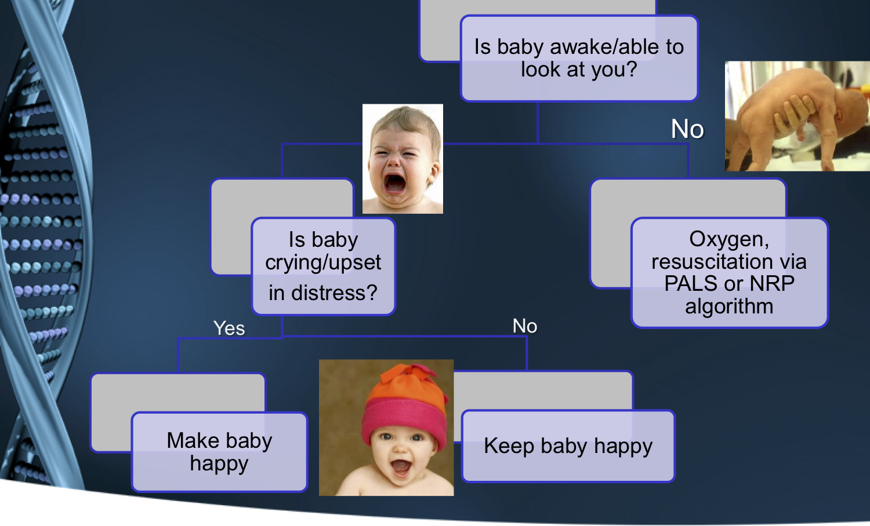

Slide 15
Clinical Senario 2
14 d/o term male presents to the ED with lethargy, poor feeding, vomiting and decreased UOP. Was initially feeding vigorously and decreased since day 6 of life.
He was a home birth with no prenatal care. Has not seen a healthcare provider. 1st born child for the family. Mother has no medical history and denies drug use.
Parents were encouraged by family to bring him to the hospital since he wasn’t feeding today with no wet diapers.

Slide 16
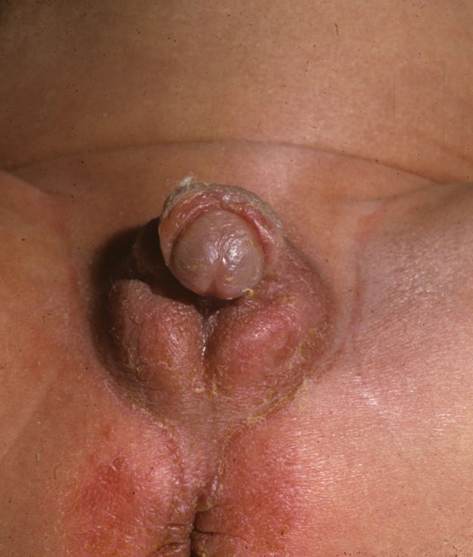
Physical exam
VS - T96.5 HR 196 BP 64/31RR 55 Wt 1.9 kg POx 97% RA
Pale, somnolent not easily aroused
Depressed Fontanelle
Dry MM
Areas of hyper-pigmentation
Weak suck
Delayed cap refill
Tachycardia no murmur
Tachypnea, no wheezes or retractions
Abdomen soft, not tender, not distended

Slide 17
Differential Diagnosis
Sepsis
Congenital Heart Disease
Pyloric Stenosis
Malrotation
Congenital Adrenal Hypoplasia
Congenital Diaphragmatic Hernia
NAT

Slide 18
Labs and Imaging
CBC - WBC 17.1 Hb 9.8 Hct 28.4 Plt 311 Pulse Ox 97% RA
BMP - Na 122 K 6.8 Cl 97 BUN 31Cr 1.4 Glc 33 Ca 9.5 HCO3 12
LFT - NL
PT/INR - NL
TBili 0.4
UA - NL
LP - NL
Capillary Blood Gas - pH 6.9
Pyloric US - NL
Head CT - NL

Slide 19
Differential Diagnosis
Sepsis
Congenital Adrenal Hypoplasia

Slide 20
Treatment
Call for transfer
ABCs - HF NC to aide to work of breathing
NS bolus for correction of shock 30ml/kg
Correction of Glucose D10 W at 5ml/kg over 10 min
Decadron 1mg IV
Ampicillin and Claforan IV

Slide 21
Congenital Adrenal Hypoplasia
21-Hydroxylase Deficiency - 90% Cases
1 in every 15,000 live births in the US
Present in shock between DOL 7-14 (10)
Present in Adrenal Crisis
No cyanosis, no respiratory issues

Slide 22
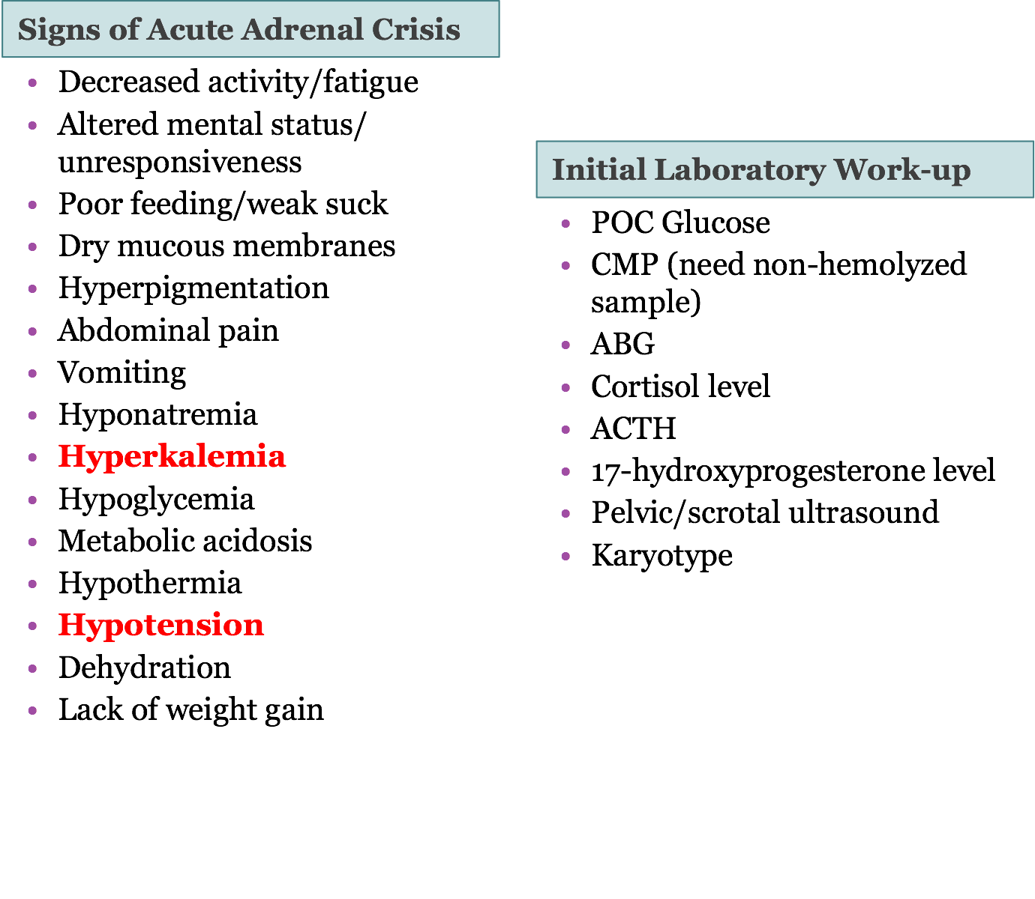

Slide 23
Clinical Senario 3
21 d/o term male with a history of GERD presents to ED with two days lethargy, persistent vomiting, and dec UOP. Symptoms have been worsening last 24 hrs.
He was born via CS due to prior CS with no complications. DC home from newborn nursery and no complications and surpassed birthweight by day 10. No fevers or sick contacts.
Vomiting started yesterday and looked like formula. It worsened throughout today and turned light and then dark green. There has been increased lethargy and no UOP for 12 hrs.

Slide 24
Physical Exam
VS - T 99.9 HR 168 BP 76/41 RR 38 Wt 3.6 kg Pulse Ox 98% RA
Somnolent not easily aroused, No rashes or cyanosis
Depressed Fontanelle
Dry MM
Weak suck
2-3 sec cap refill +2 peripheral pulses
Tachycardia no murmurs no gallops
CTAB with no distress
Abdomen distended with scant BS

Slide 25
Differential Diagnosis
Sepsis
Pyloric Stenosis
Malrotation
Midgut Volvulus
Cardiac Arrhythmia
Intracranial Mass
NAT

Slide 26
Labs and Imaging
CBC - WBC 27.3 Hb 9.6 Hct 29.4 Plt 281
BMP - Na 126 K 3.4 Cl 96 BUN 27 Cr 1.14 Glc 59 Ca 9.9 HCO3 15
LFT - ALT 48 AST 69
PT/INR - NL
TBili 0.6
UA - NL
LP - NL
Venous Blood Gas - pH 7.21
Pyloric US - NL
Head CT - NL

Slide 27
Differential Diagnosis
Sepsis
Malrotation

Slide 28
Treatment
Call for transfer
NS IV fluid bolus 20ml/kg
NGT placement
Ampicillin and Claforan IV

Slide 29
Malrotation
Symptomatic Malrotation occurs in 1 in 6000 live births
  Midgut Volvulus MC
May occur at any age
Associated with other congenital abnormalities
40% present in 1st week, 50% in 1st month, and 75% in 1st year
Present with sudden bilious vomiting and abdominal distention
Typically present in shock with metabolic acidosis and peritonitis and elevated lactate is a late finding
Exam can also be normal so don’t ignore complaint - X-ray needed (double bubble)
Placement of NG/OG and Fluid resuscitation with correction of electrolytes
If in refractory shock Dopamine is 1st line due to inc of splanchnic blood flow

Slide 30
Malrotation
Present with signs of bowel obstruction
Bilious vomiting in the neonate is an indication of malrotation until proven otherwise and is usually due to acute volvulus
Acute duodenal obstruction occurs mainly in infants and involves the compression of the duodenum by Ladd bands. Patients demonstrate forceful vomiting.
Diagnostic findings on a plain radiograph include an abnormally positioned duodenum as shown by placement of a nasogastric tube, and the “double-bubble” sign specific to duodenal obstruction.
Be aware that plain radiographs may be completely normal in individuals with malrotation as well.
Gold standard – upper GI study with contrast. These include visualization of a misplaced duodenum with a “corkscrew” appearance, and duodenal obstruction.
Other imaging modalities that may be used include a lower GI series (contrast enema), ultrasound, and CT scanning.
Volvulus is a surgical emergency, delay in untwisting bowel can lead to ischemic necrosis

Slide 31
Review
Early recognition and early transfer is key
Always consider NAT and Sepsis
No need for definite diagnosis
Always consider intubation
Aggressive resuscitation

